Slide 1
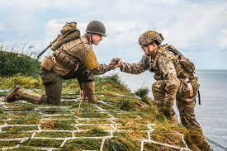
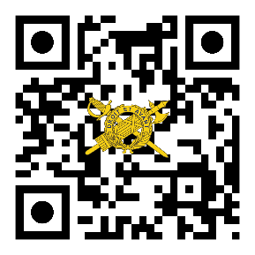
THE
IG UPDATE
Volume 22-7, JUNE 2022
IG Update 22-7: Guidance for Commanders; Army Emergency Relief (AER) Campaign
*AER is the only non-profit organization that command teams can and should openly endorse.
Since March 1942, AER has provided Soldiers and their dependents with assistance and emergency aid in the form of loans, grants, and scholarships.
Funds for this program come from various sources, including the annual campaign (as authorized by Army Regulation 600-29).
The AER annual campaign is the responsibility of the senior commander/senior command sergeant major (in coordination with garrison commander/garrison sergeant major). Commanders should continuously inform and encourage their Soldiers to use AER when they have a valid financial need.
The following “Do’s and Don’ts” will help command teams understand how they can best support the AER annual campaign while remaining within regulatory limits.
DO:
Establish an officer/NCO installation campaign coordination team (comprised of a field-grade officer and senior NCO).
Ensure the Campaign Coordination Team coordinates directly with the ACS staff and the AER team during campaign season.
Every company-level unit will appoint an AER campaign representative (SSG or above) who will work with the installation’s campaign coordination team.
Endorse/publicize the campaign through usual campaign activities, memorandums, digital platforms or other communication.
Provide Soldiers the opportunity to make voluntary donations. (use of a ‘thermometer’ graph is appropriate to show progress of the entire installation
goal (if established) or the installation’s total contribution.)
Follow up on solicitations where the individual asked to delay or defer decision.
Keep appropriate awards as commendation for exceptional performance in the organization and administration of a campaign.
Recognize exceptional performance in organization of a campaign or administration (e.g., letter of commendation).
Provide an after-action report regarding their AER campaign.
DON’T:
Conduct this campaign in conjunction with another campaign (e.g., CFC).
Solicit Soldiers under your direct supervision (e.g., a platoon sergeant will inform their platoon about AER assistance, but cannot solicit donations from their platoon).
Tell individuals they are the only one, or one of a small number of people, preventing the achievement of an installation’s goal.
Keep lists of noncontributors for any purpose.
Initiate awards or rewards for individual solicitors, or grant special privileges, favors, or entitlements as inducement to contribute.
https://ig.army.mil
Department of the Army Inspector General
The Inspector General
LTG Donna W. Martin
Deputy, The Inspector General
MG Mitchell L. Kilgo
The Inspector General Sergeant Major
SGM Larry H. Orvis
References and Resources
AR 600-29 (Fund-Raising within the Department of the Army)
AR 930-4 (Service Organizations-Army Emergency Relief)
https://www.armyemergencyrelief.org

